Slide 1
Chapter 3
Simple Regression Analysis
(Part 1)
Terry Dielman
Applied Regression Analysis:
A Second Course in Business and Economic Statistics, fourth edition
Simple Regression I
Copyright © 2005 Brooks/Cole, a division of Thomson Learning, Inc.

Slide 2
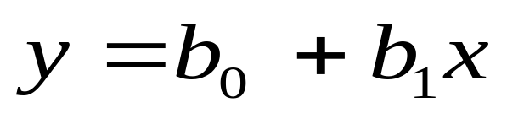
3.1 Using Simple Regression to Describe a Relationship
Regression analysis is a statistical technique used to describe relationships among variables.
The simplest case is one where a dependent variable y may be related to an independent or explanatory variable x.
The equation expressing this relationship is the line:
Simple Regression I
Copyright © 2005 Brooks/Cole, a division of Thomson Learning, Inc.

Slide 3
Slope and Intercept
For a given set of data, we need to calculate values for the slope b₁ and the intercept b₀.
Figure 3.1 shows the graph of a set of six (x, y) pairs that have an exact relationship.
Ordinary algebra is all you need to compute y = 1 + 2x
Simple Regression I
Copyright © 2005 Brooks/Cole, a division of Thomson Learning, Inc.

Slide 4
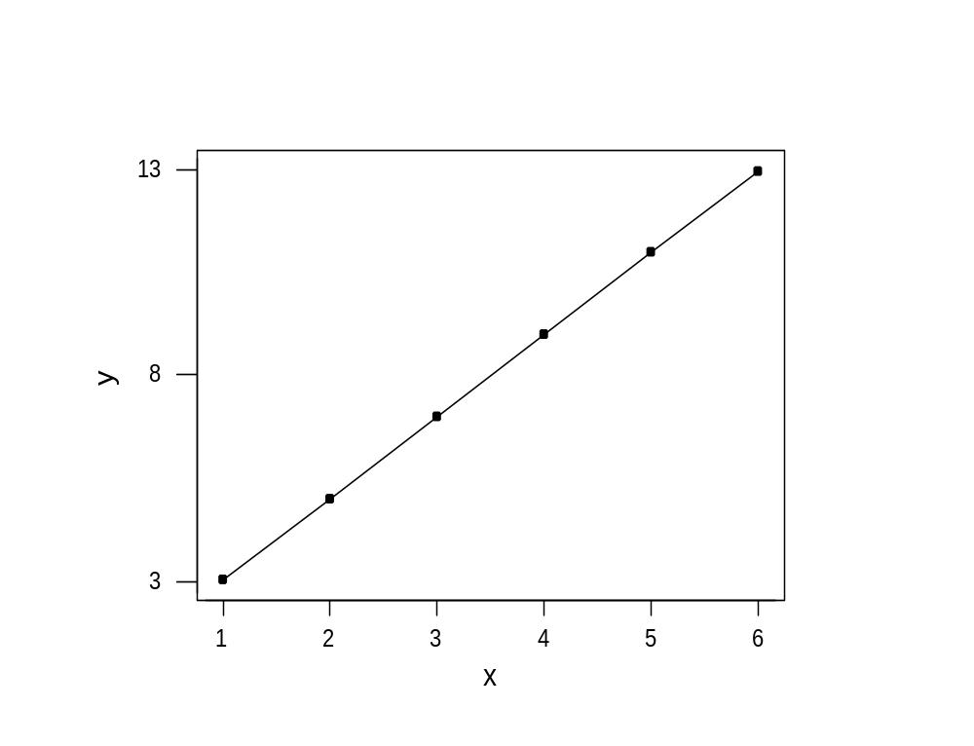
Figure 3.1 Graph of An Exact Relationship
x | y
1 | 3
2 | 5
3 | 7
4 | 9
5 | 11
6 | 13
Simple Regression I
Copyright © 2005 Brooks/Cole, a division of Thomson Learning, Inc.

Slide 5
Error in the Relationship
In real life, we usually do not have exact relationships.
Figure 3.2 shows a situation where the y and x have a strong tendency to increase together but it is not perfect.
You can use a ruler to put a line in approximately the "right place" and use algebra again.
^
A good guess might be y = 1 + 2.5x
Simple Regression I
Copyright © 2005 Brooks/Cole, a division of Thomson Learning, Inc.

Slide 6
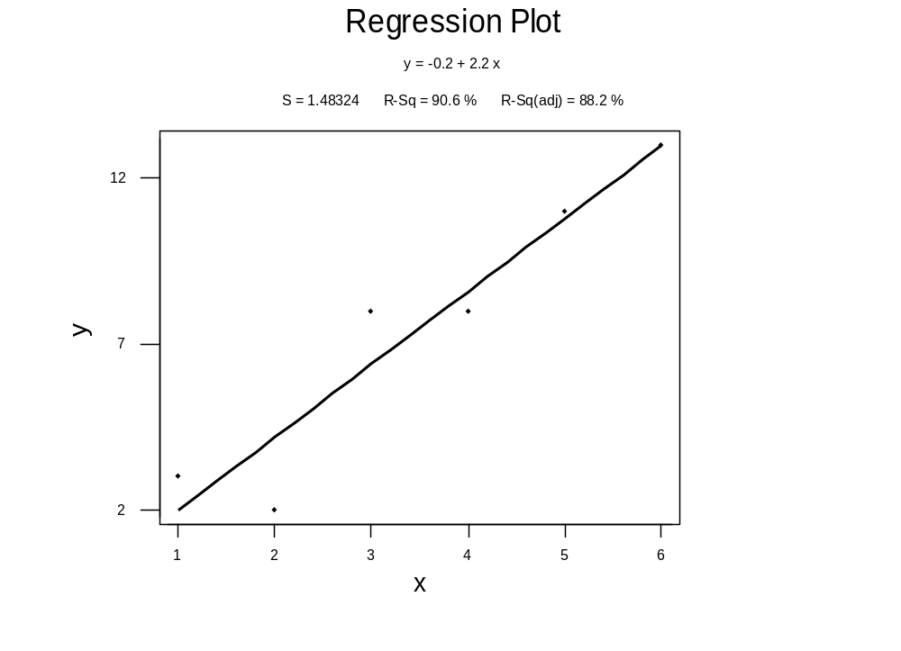
Figure 3.2 Graph of a Relationship That is NOT Exact
x | y
1 | 3
2 | 2
3 | 8
4 | 8
5 | 11
6 | 13
Simple Regression I
Copyright © 2005 Brooks/Cole, a division of Thomson Learning, Inc.

Slide 7
Everybody Is Different
The drawback to this technique is that everybody will have their own opinion about where the line goes.
There would be ever greater differences if there were more data with a wider scatter.
We need a precise mathematical technique to use for this task.
Simple Regression I
Copyright © 2005 Brooks/Cole, a division of Thomson Learning, Inc.

Slide 8
Residuals
Figure 3.3 shows the previous graph where the "fit error" of each point is indicated.
These residuals are positive if the point is above the line and negative if the line is above the point.
We want a technique that will make the + and – even out.
Simple Regression I
Copyright © 2005 Brooks/Cole, a division of Thomson Learning, Inc.

Slide 9
Figure 3.3 Deviations From the Line
+ deviations
- deviations
Simple Regression I
Copyright © 2005 Brooks/Cole, a division of Thomson Learning, Inc.

Slide 10
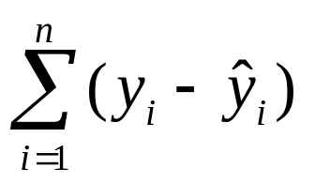
Computation Ideas (1)
We can search for a line that minimizes the sum of the residuals:
While this is a good idea, it can be shown that any line passing through the point (x, y) will have this sum = 0.
Simple Regression I
Copyright © 2005 Brooks/Cole, a division of Thomson Learning, Inc.

Slide 11
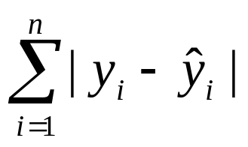
Computation Ideas (2)
We can work with absolute values and search for a line that minimizes:
Such a procedure—called LAV or least absolute value regression—does exist but usually is found only in specialized software.
Simple Regression I
Copyright © 2005 Brooks/Cole, a division of Thomson Learning, Inc.

Slide 12
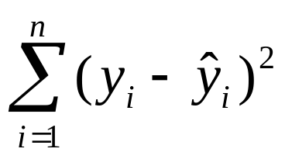
Computation Ideas (3)
By far the most popular approach is to square the residuals and minimize:
This procedure is called least squares and is widely available in software. It uses calculus to solve for the b₀ and b₁ terms and gives a unique solution.
Simple Regression I
Copyright © 2005 Brooks/Cole, a division of Thomson Learning, Inc.

Slide 13
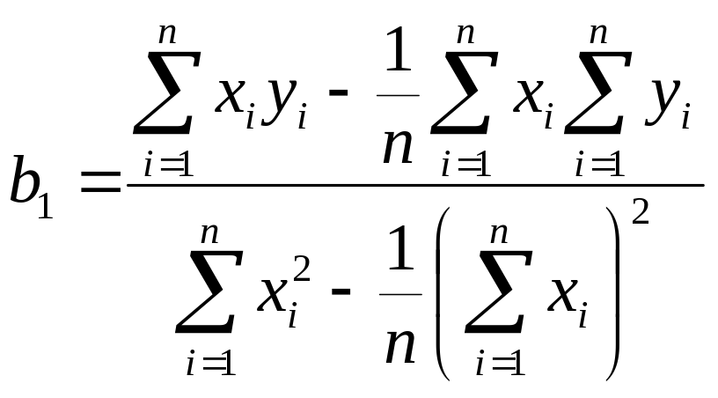
Least Squares Estimators
There are several formula for the b₁ term. If doing it by hand, we might want to use:
_ _
The intercept is b₀ = y – b₁ x
Simple Regression I
Copyright © 2005 Brooks/Cole, a division of Thomson Learning, Inc.

Slide 14
Figure 3.5
Computations
Required for b₁ and b₀
x_{i} | y_{i} | x_{i}² | x_{i}y_{i}
1 | 3 | 1 | 3
2 | 2 | 4 | 4
3 | 8 | 9 | 24
4 | 8 | 16 | 32
5 | 11 | 25 | 55
6 | 13 | 36 | 78
21 | 45 | 91 | 196
Totals
Simple Regression I
Copyright © 2005 Brooks/Cole, a division of Thomson Learning, Inc.

Slide 15
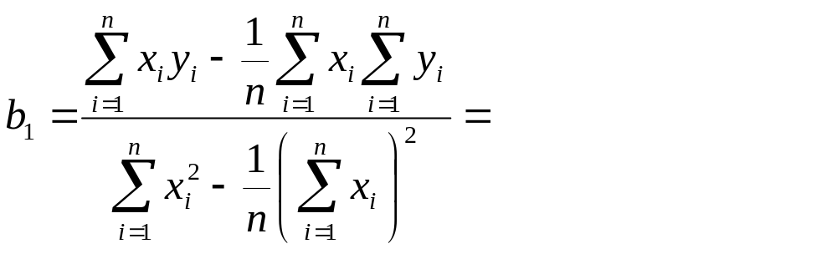
Calculations
_ _
b₀ = y – b₁ x =
Simple Regression I
Copyright © 2005 Brooks/Cole, a division of Thomson Learning, Inc.

Slide 16
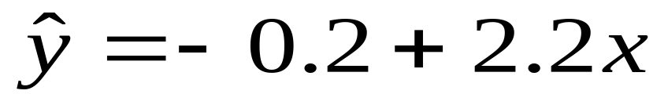
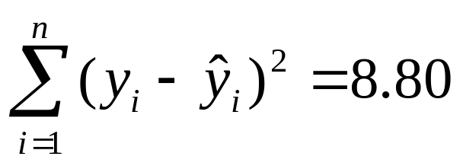
The Unique Minimum
The line we obtained was:
The sum of squared errors (SSE) is:
No other linear equation will yield a smaller SSE. For the line 1 + 2.5x we guessed earlier, the SSE is 10.75
Simple Regression I
Copyright © 2005 Brooks/Cole, a division of Thomson Learning, Inc.

Slide 17
3.2 Examples of Regression as a Descriptive Technique
Example 3.2 Pricing Communications Nodes
A Ft. Worth manufacturing company was concerned about the cost of adding nodes to a communications network. They obtained data on 14 existing nodes.
They did a regression of cost (the y) on number of ports (x).
Simple Regression I
Copyright © 2005 Brooks/Cole, a division of Thomson Learning, Inc.

Slide 18
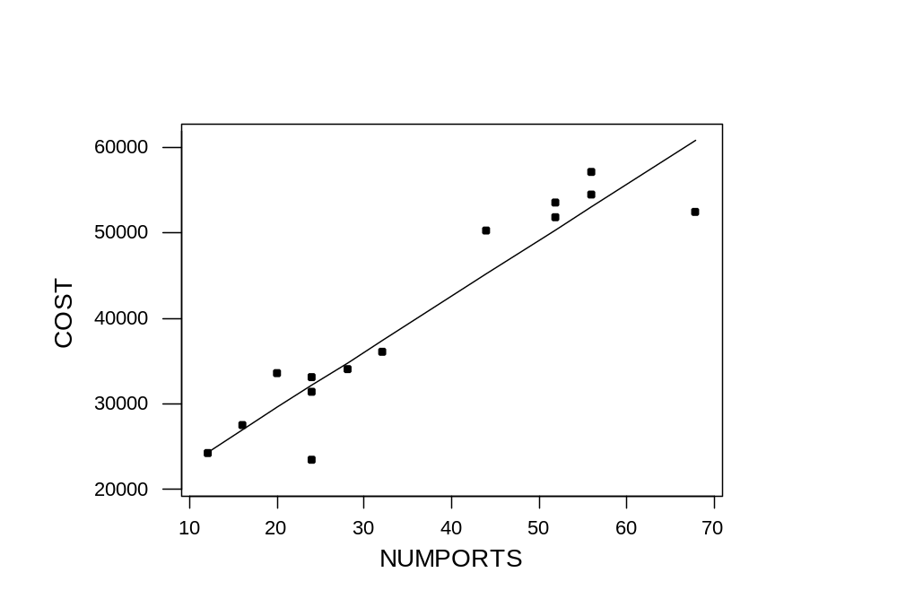
Pricing Communications Nodes
Cost = 16594 + 650 NUMPORTS
Simple Regression I
Copyright © 2005 Brooks/Cole, a division of Thomson Learning, Inc.

Slide 19
Example 3.3 Estimating Residential Real Estate Values
The Tarrant County Appraisal District uses data such as house size, location and depreciation to help appraise property.
Regression can be used to establish a weight for each factor. Here we look at how price depends on size for a set of 100 homes. The data are from 1990.
Simple Regression I
Copyright © 2005 Brooks/Cole, a division of Thomson Learning, Inc.

Slide 20
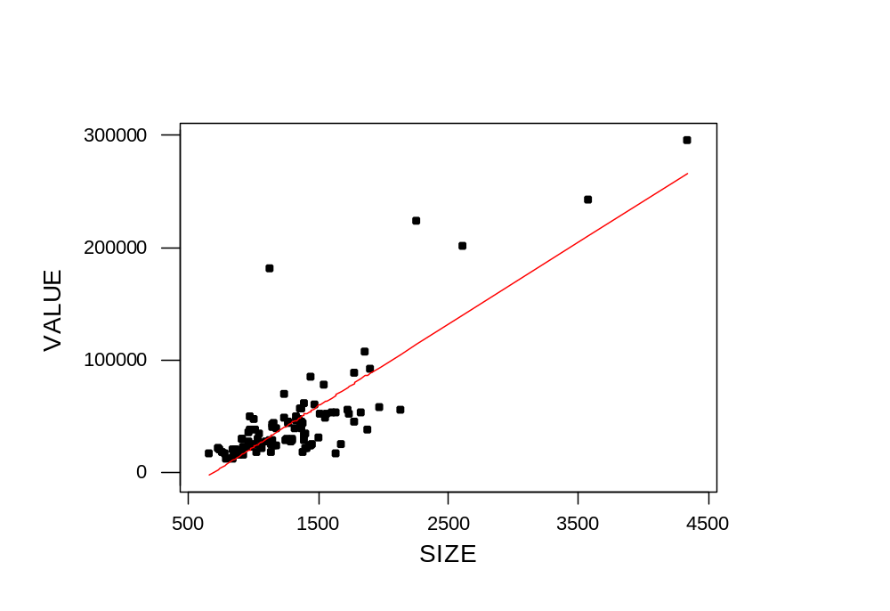
Tarrant County Real Estate
VALUE = -50035 + 72.8 SIZE
Simple Regression I
Copyright © 2005 Brooks/Cole, a division of Thomson Learning, Inc.

Slide 21
Example 3.4 Forecasting Housing Starts
Forecasts of various economic measures is important to the government and various industries.
Here we analyze the relationship between US housing starts and mortgage rates. The rate used is the US average for new home purchases.
Annual data from 1963 to 2002 is used.
Simple Regression I
Copyright © 2005 Brooks/Cole, a division of Thomson Learning, Inc.

Slide 22
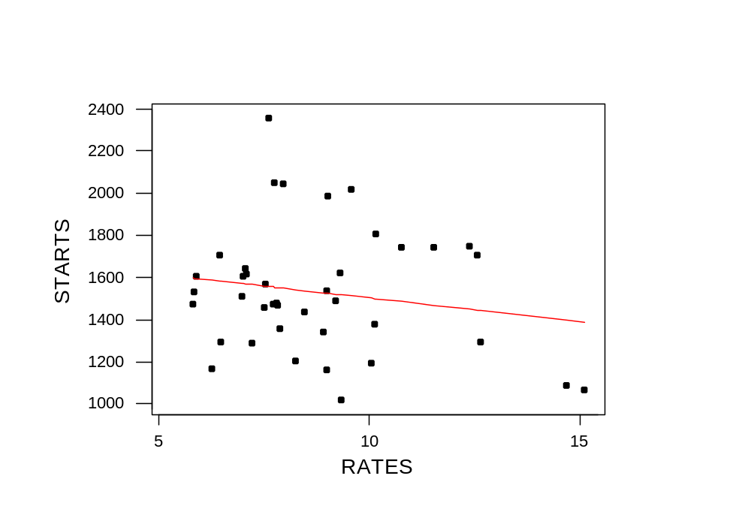
US Housing Starts
STARTS = 1726 - 22.2 RATES
Simple Regression I
Copyright © 2005 Brooks/Cole, a division of Thomson Learning, Inc.

Slide 23
3.3 Inferences From a Simple Regression Analysis
So far regression has been used as a way to describe the relationship between the two variables.
Here we will use our sample data to make inferences about what is going on in the underlying population.
To do that, we first need some assumptions about how things are.
Simple Regression I
Copyright © 2005 Brooks/Cole, a division of Thomson Learning, Inc.

Slide 24
3.3.1 Assumptions Concerning the Population Regression Line
Lets use the communications nodes example to illustrate. Costs ranged from roughly $23000 to $57000 and number of ports from 12 to 68.
Three times we had projects with 24 ports, but the three costs were all different. The same thing occurred at repeated observations at 52 and 56 ports.
This illustrates how we view things: at each value of x there is a distribution of potential y values that can occur.
Simple Regression I
Copyright © 2005 Brooks/Cole, a division of Thomson Learning, Inc.

Slide 25
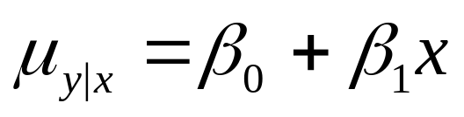
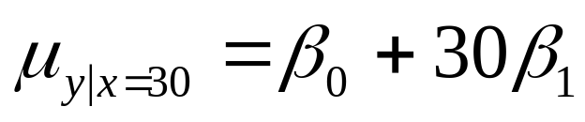
The Conditional Mean
Our first assumption is that the means of these distributions all lie on a straight line:
For example, at projects with 30 ports, we have:
The actual cost of projects with 30 ports are going to be distributed about the mean. This also happens at other sizes of projects, so you might see something like the next slide.
Simple Regression I
Copyright © 2005 Brooks/Cole, a division of Thomson Learning, Inc.

Slide 26

Figure 3.12 Distribution of Costs around the Regression Line
Cost
β₀ + β₁ Nodes
Nodes
12
30
68
Simple Regression I
Copyright © 2005 Brooks/Cole, a division of Thomson Learning, Inc.

Slide 27
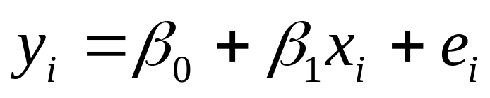
The Disturbance Terms
Because of the variation around the regression line, it is convenient to view the individual costs as:
The e_{i} are called the disturbances and represent how y_{i} differs from its conditional mean. If y_{i} is above the mean, its disturbance has a + value.
Simple Regression I
Copyright © 2005 Brooks/Cole, a division of Thomson Learning, Inc.

Slide 28
Assumptions
We expect the average disturbance e_{i} to be zero so the regression line passes through the conditional mean of y.
The e_{i} have constant variance σ_{e}².
The e_{i} are normally distributed.
The e_{i} are independent.
Simple Regression I
Copyright © 2005 Brooks/Cole, a division of Thomson Learning, Inc.

Slide 29
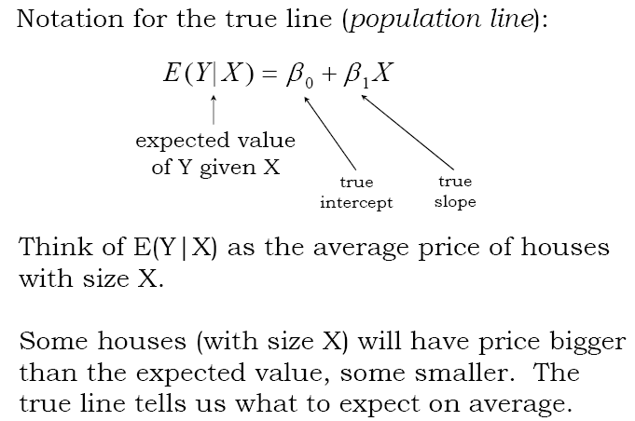
Simple Regression I
Copyright © 2005 Brooks/Cole, a division of Thomson Learning, Inc.

Slide 30
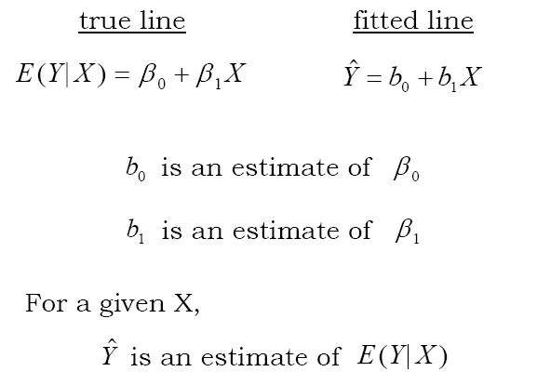
Simple Regression I
Copyright © 2005 Brooks/Cole, a division of Thomson Learning, Inc.

Slide 31
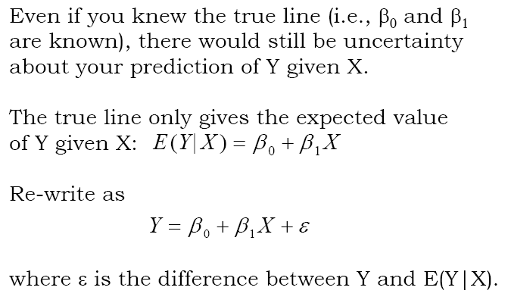
Simple Regression I
Copyright © 2005 Brooks/Cole, a division of Thomson Learning, Inc.

Slide 32
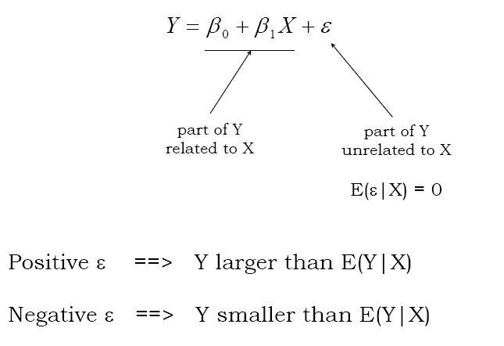
Simple Regression I
Copyright © 2005 Brooks/Cole, a division of Thomson Learning, Inc.

Slide 33
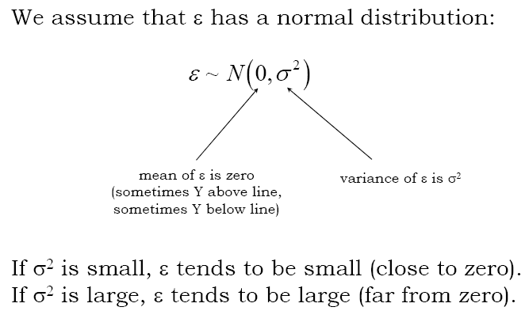
Simple Regression I
Copyright © 2005 Brooks/Cole, a division of Thomson Learning, Inc.

Slide 34
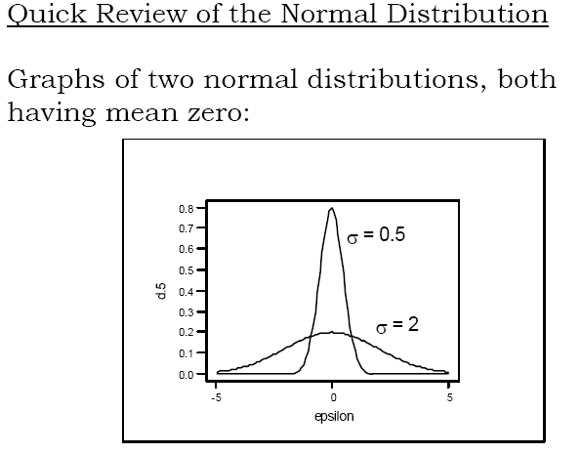
Simple Regression I
Copyright © 2005 Brooks/Cole, a division of Thomson Learning, Inc.

Slide 35
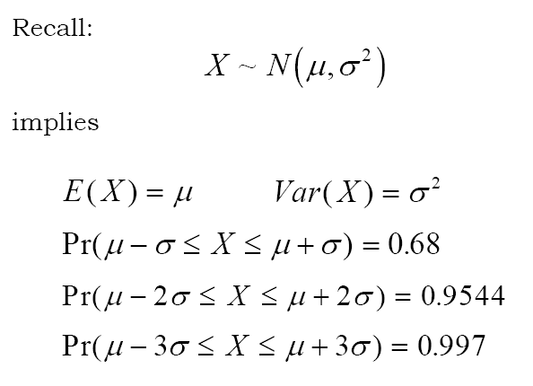
Simple Regression I
Copyright © 2005 Brooks/Cole, a division of Thomson Learning, Inc.

Slide 36
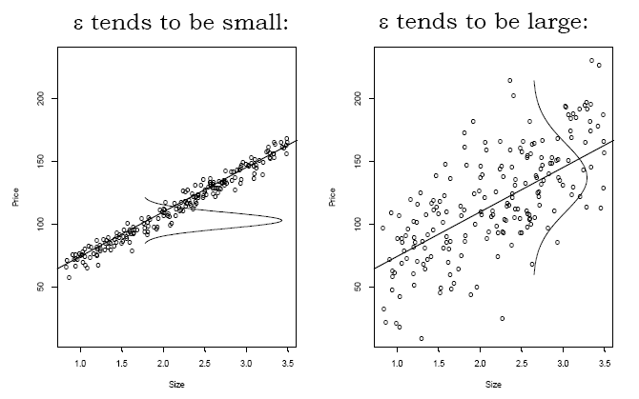
Simple Regression I
Copyright © 2005 Brooks/Cole, a division of Thomson Learning, Inc.

Slide 37
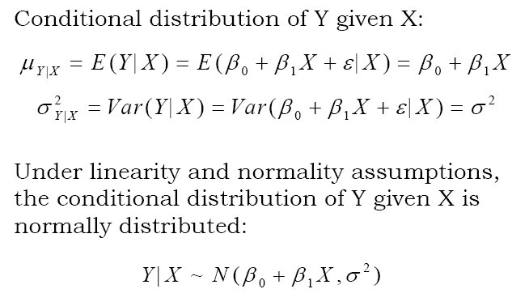
Simple Regression I
Copyright © 2005 Brooks/Cole, a division of Thomson Learning, Inc.

Slide 38
3.3.2 Inferences About β₀ and β₁
We use our sample data to estimate β₀ by b₀ and β₁ by b₁. If we had a different sample, we would not be surprised to get different estimates.
Understanding how much they would vary from sample to sample is an important part of the inference process.
We use the assumptions, together with our data, to construct the sampling distributions for b₀ and b₁.
Simple Regression I
Copyright © 2005 Brooks/Cole, a division of Thomson Learning, Inc.

Slide 39
The Sampling Distributions
The estimators have many good statistical properties. They are unbiased, consistent and minimum variance.
They have normal distributions with standard errors that are functions of the x values and σ_{e}².
Full details are in Section 3.3.2
Simple Regression I
Copyright © 2005 Brooks/Cole, a division of Thomson Learning, Inc.

Slide 40
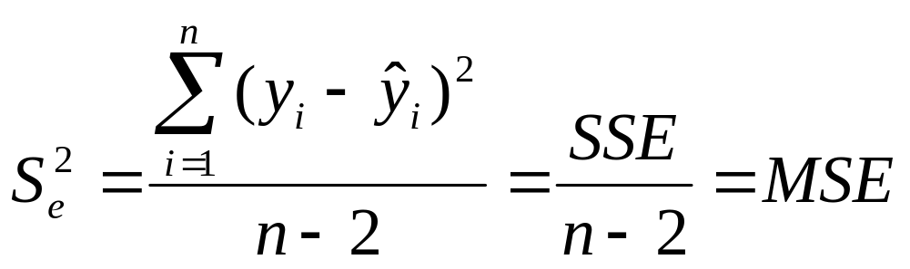
Estimate of σ_{e}²
This is an unknown quantity that needs to be estimated from data.
We estimate it by the formula:
The term MSE stands for mean squared error and is more or less the average squared residual.
Simple Regression I
Copyright © 2005 Brooks/Cole, a division of Thomson Learning, Inc.

Slide 41
Standard Error of the Regression
The divisor n-2 used in the previous calculation follows our general rule that degrees of freedom are sample size – the number of estimates we make (b₀ and b₁) before estimating the variance.
The square root of MSE is S_{e} which we call the standard error of the regression.
S_{e} can be roughly interpreted as the "typical" amount we miss in estimating each y value.
Simple Regression I
Copyright © 2005 Brooks/Cole, a division of Thomson Learning, Inc.

Slide 42
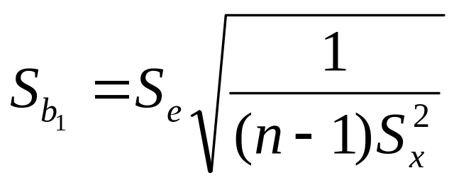
Inference About β₁
Interval estimates and hypothesis tests are constructed using the sampling distribution of b₁.
The standard error of b₁ is:
Computer programs routinely compute this and report its value.
Simple Regression I
Copyright © 2005 Brooks/Cole, a division of Thomson Learning, Inc.

Slide 43
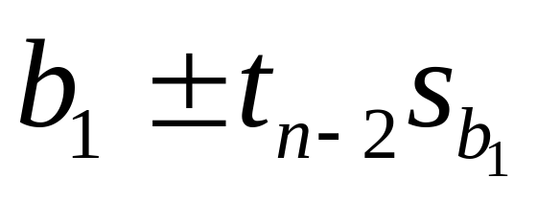
Interval Estimate
The distribution we use is a t with
  n-2 degrees of freedom.
The interval is:
The value of t, of course, depends on the selected confidence level.
Simple Regression I
Copyright © 2005 Brooks/Cole, a division of Thomson Learning, Inc.

Slide 44
Tests About β₁
The most common test is that a change in the x variable does not induce a change in y, which can be stated:
  H₀: β₁ = 0
  H_{a}: β₁ ≠ 0
If H₁ is true it implies the population regression equation is a flat line; that is, regardless of the value of x, y has the same distribution.
Simple Regression I
Copyright © 2005 Brooks/Cole, a division of Thomson Learning, Inc.

Slide 45
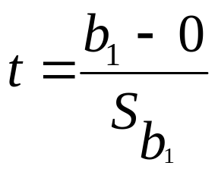
Test Statistic
The test would be performed by using the standardized test statistic:
Most computer programs compute this, and its associated p-value. and include them on the output.
The p-value is for the two-sided version of the test.
Simple Regression I
Copyright © 2005 Brooks/Cole, a division of Thomson Learning, Inc.

Slide 46
Inference About β₀
We can also compute confidence intervals and perform hypothesis tests about the intercept in the population equation.
Details about the tests and intervals are in Section 3.3.2, but in most problems we are not interested in this.
The intercept is the value of y at x=0 and in many problems this is not relevant; for example, we never see houses with zero square feet of floor space.
Sometimes it is relevant, anyway. If we are estimating costs, we could interpret the intercept as the fixed cost. Even though we never see communication nodes with zero ports, there is likely to be a fixed cost associated with setting up each project.
Simple Regression I
Copyright © 2005 Brooks/Cole, a division of Thomson Learning, Inc.

Slide 47
Example 3.6 Pricing Communications Nodes (continued)
Inference questions:
  What is the equation relating NUMPORTS to COST?
  Is the relationship significant?
  What is an interval estimate of β₁?
  Is the relationship positive?
  Can we claim each port costs at least $1000?
  What is our estimate of fixed cost?
  Is the intercept 0?
Simple Regression I
Copyright © 2005 Brooks/Cole, a division of Thomson Learning, Inc.

Slide 48
Minitab Regression Output
Regression Analysis: COST versus NUMPORTS
The regression equation is
COST = 16594 + 650 NUMPORTS
Predictor Coef SE Coef T P
Constant 16594 2687 6.18 0.000
NUMPORTS 650.17 66.91 9.72 0.000
S = 4307 R-Sq = 88.7% R-Sq(adj) = 87.8%
Analysis of Variance
Source DF SS MS F P
Regression 1 1751268376 1751268376 94.41 0.000
Residual Error 12 222594146 18549512
Total 13 1973862521
Simple Regression I
Copyright © 2005 Brooks/Cole, a division of Thomson Learning, Inc.

Slide 49
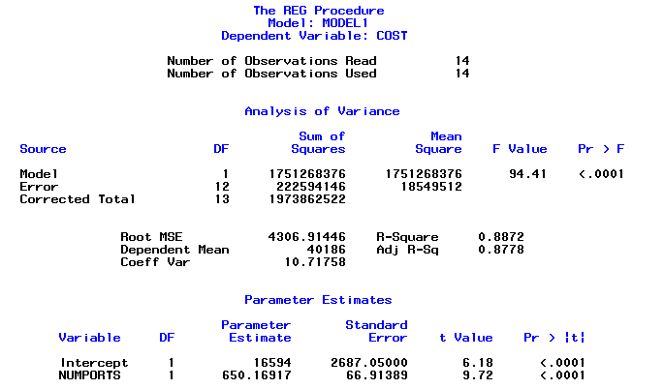
SAS Regression Output
Simple Regression I
Copyright © 2005 Brooks/Cole, a division of Thomson Learning, Inc.

Slide 50
Is the relationship significant?
H₀: β₁ = 0 (Cost does not change when
number of ports increase)
H_{a}: β₁ ≠ 0 (Cost does change)
We will use a 5% level of significance and the t distribution with (n-2) = 12 degrees of freedom.
Decision rule: Reject H₀ if t > 2.179
or if t < -2.179
from Minitab output t = 9.72 (p-value =.000)
We conclude that there is a significant relationship between project size and cost.
Simple Regression I
Copyright © 2005 Brooks/Cole, a division of Thomson Learning, Inc.

Slide 51
What is an interval estimate of β₁?
Interval is:
For a 95% interval use t = 2.179
650.17 ± 2.179(66.91) = 650.17 ± 145.80
We are 95% sure that the average cost for each additional node is between $504 and $796.
Simple Regression I
Copyright © 2005 Brooks/Cole, a division of Thomson Learning, Inc.

Slide 52
Can we claim a positive relationship?
H₀: β₁ = 0 (Cost does not change when size increases)
H_{a}: β₁ > 0 (Cost increases when size increases)
We will use a 5% level of significance and the t distribution with (n-2) = 12 degrees of freedom.
Decision rule: Reject H₀ if t > 1.782
From Minitab output t = 9.72 (p-value is half of the listed value of .000, which is still .000)
We conclude that the project cost does increase with project size.
Simple Regression I
Copyright © 2005 Brooks/Cole, a division of Thomson Learning, Inc.

Slide 53
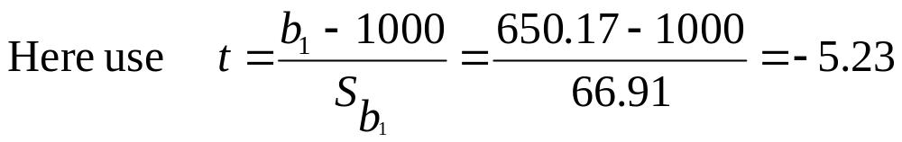
Is the cost per port at least $1000?
H₀: β₁ ≥ 1000 (Cost per port at least $1000)
H_{a}: β₁ < 1000 (Cost is less than $1000)
Again we will use a 5% level of significance and 12 degrees of freedom.
Decision rule: Reject H₀ if t < -1.782
We conclude that the cost per node is (much) less than $1000.
Simple Regression I
Copyright © 2005 Brooks/Cole, a division of Thomson Learning, Inc.

Slide 54
Is the cost per port at least $1000?
H₀: β₁ <= 1000 (Cost per port at least $1000)
H_{a}: β₁ > 1000 (Cost is less than $1000)
Again we will use a 5% level of significance and 12 degrees of freedom.
Decision rule: Reject H₀ if t > 1.782
We conclude that the cost per node is (much) less than $1000.
Simple Regression I
Copyright © 2005 Brooks/Cole, a division of Thomson Learning, Inc.

Slide 55
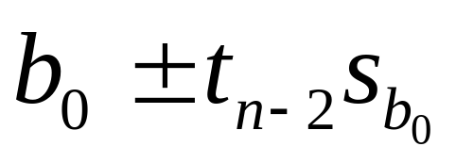
What is our estimate of fixed cost?
We can interpret the intercept of the equation as fixed cost, and the slope as variable cost. For the intercept, an interval is:
16594 ± 2.179(2687) = 16954 ± 5855
We are 95% sure the fixed cost is between $11,099 and $22,809.
Simple Regression I
Copyright © 2005 Brooks/Cole, a division of Thomson Learning, Inc.

Slide 56
Is the intercept 0?
H₀: β₀ = 0 (Fixed cost is 0)
H_{a}: β₀ ≠ 0 (Fixed cost is not 0)
Again, use a 5% level of significance and 12 d.f.
Decision rule: Reject H₀ if t > 2.179
or if t < -2.179
from Minitab output t = 6.18 (p-value =.000)
We conclude that the fixed cost is not zero.
Simple Regression I
Copyright © 2005 Brooks/Cole, a division of Thomson Learning, Inc.

